Slide 1
IF YOU WANT TO GO FAST, GO ALONE IF YOU WANT TO GO FAR, GO TOGETHER!! - African Proverb

Slide 2
COMPANY NETWORK IMPLEMENTING ROUTING PROTOCOL AND LAN SWITCHING
MENTOR : Mr. Gourav sharma
Ashish kumar DEEPAK CHOPRA
06425602714 06325602714

Slide 3
INTRODUCTION
COMPANY HAVING COMPUTER NETWORK
A computer network or data network is a telecommunications network which allows computers to exchange data.
In computer networks, networked computing devices exchange data with each other using a data link.
The connections between nodes are established using either cable media or wireless media.

Slide 4
The best-known computer network is the Internet.
This project helps an organization to establish WAN network and the network is secured for the user.
It also reduces the wastage of IP Addresses.
Sub-netting is used here for creating the networks in a network.
Many security features and technologies are also implemented on this network.

Slide 5
OBJECTIVE
Creating a company network have best routing protocol for the given scenario and show LAN switching.
To create a better communication at different branches of the company at different locations
Features :-
The network is secured.
It is easy to understand the whole network.
Networking is done by areas.
Easy to troubleshoot.
Whole of the network is intelligent.

Slide 6
EFFECTIVENESS
This project is designed to provide security in your network to secure your private data and make a reliable and excellent communication in a WAN connection.
The network is secured & easy to understand.
Easy to troubleshoot because of its easy understanding.
We can extend the range of slots in routers.
Networking By areas.

Slide 7
PROJECT WORKING
This project consist of 5 routers.
The main router is the Delhi Router which is further connected to Nirman Vihar and Vaishali router which are connected to Dwarka and Ghaziabad router respectively.
The main Delhi Router is Password protected and it is assumed that headquarter of the company is located there.
It is assumed that the other offices of company are located at different places like: Dwarka, Nirman Vihar, Ghaziabad and Vaishali.

Slide 8
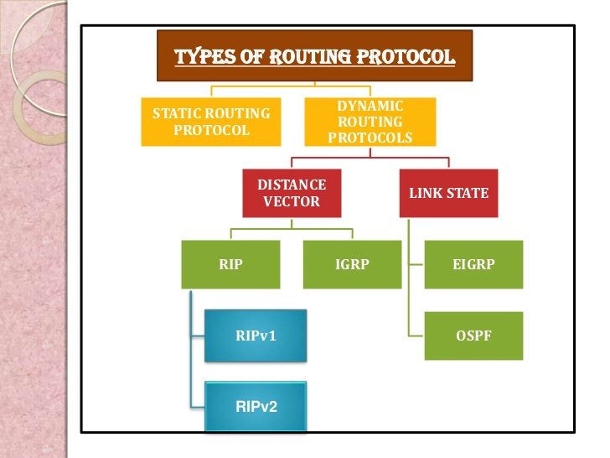
ROUTING INFORMATION PROTOCOL (RIP)
RIP is a true distance-vector routing protocol.
RIP Features:
Distance Vector Routing Protocol
Maximum Reachable hop-count is 15
Hop 16 is considered unreachable
Metric is HOP COUNT
Administrative distance 120
Sends periodic update every 30 seconds

Slide 9
VLAN (Virtual LAN)
VLANs are operating at OSI Layer 2.
VLANs can be characterized as “logically separated networks”.
The devices, which are member of same Vlan, are able to communicate with each other.
The devices of different Vlan may communicate with each other with routing.
So that different Vlan devices will use different networking addresses.
Advantage – To enhance Network Security.

Slide 10
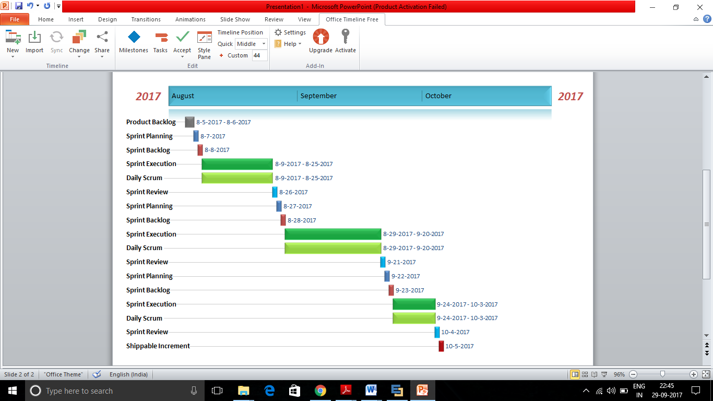
TIMEPLAN AND WORK COMPLETED

Slide 11
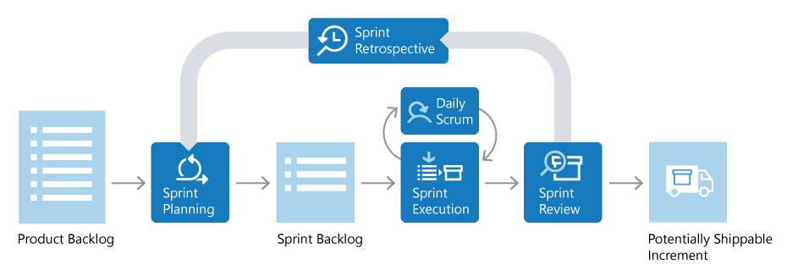
FIGURE I : FLOW DEPICTION OF SCRUM
NOTE: Gantt chart uses a Software Development methodology among Agile Methodology, knows as Scrum.

Slide 12
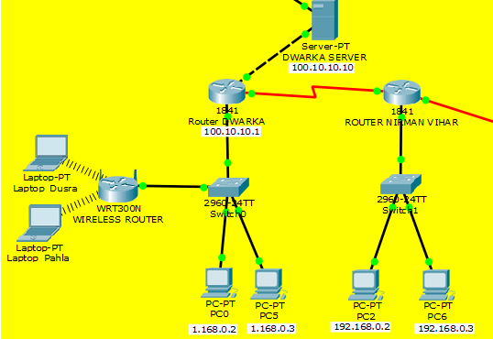
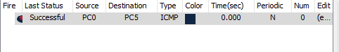
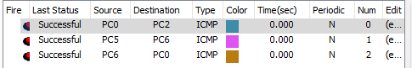
PROJECT SCREENSHOTS
COMMUNICATING IN SAME NETWORK & DIFFERENT NETWORK

Slide 13
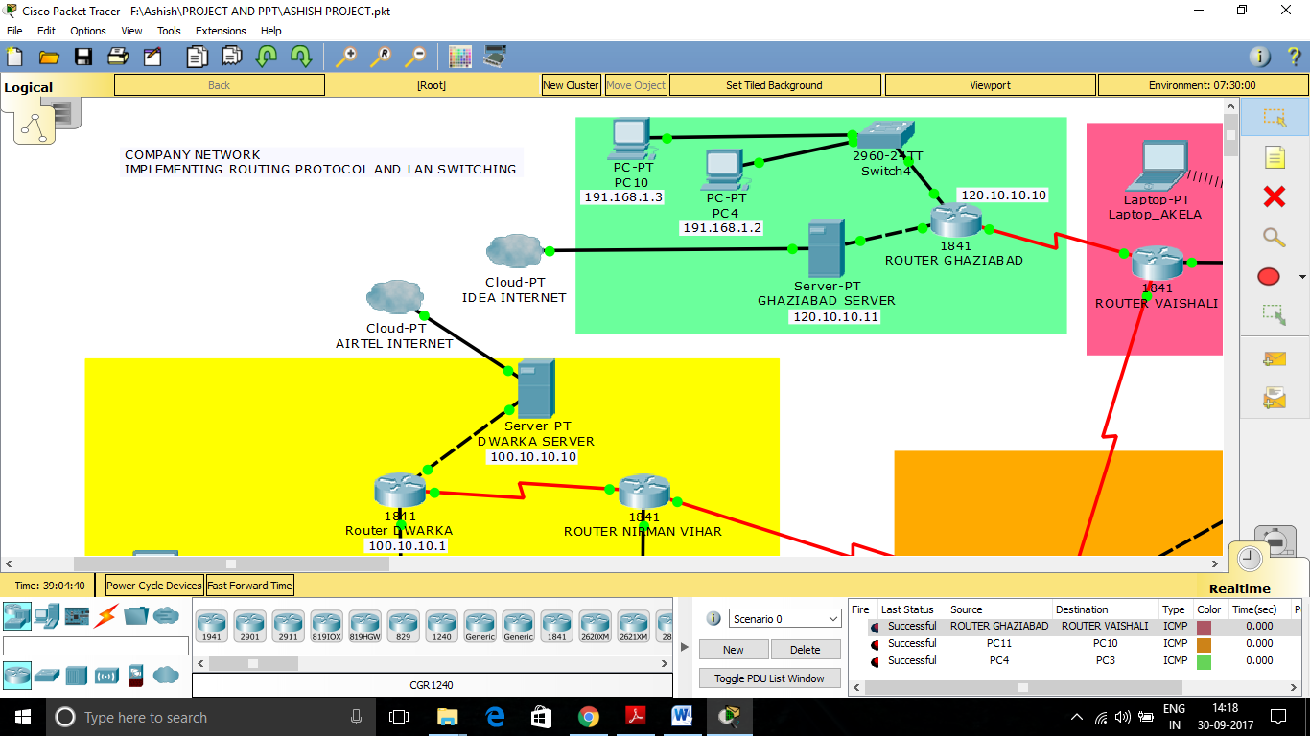
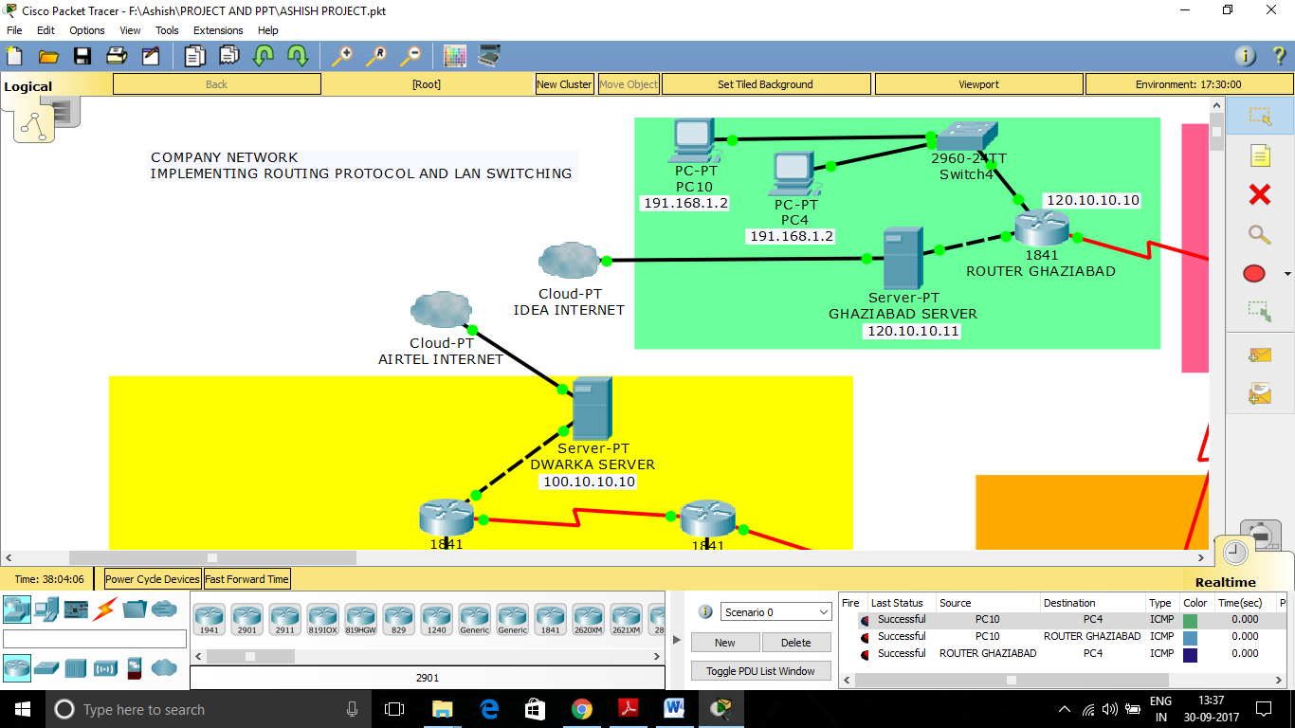
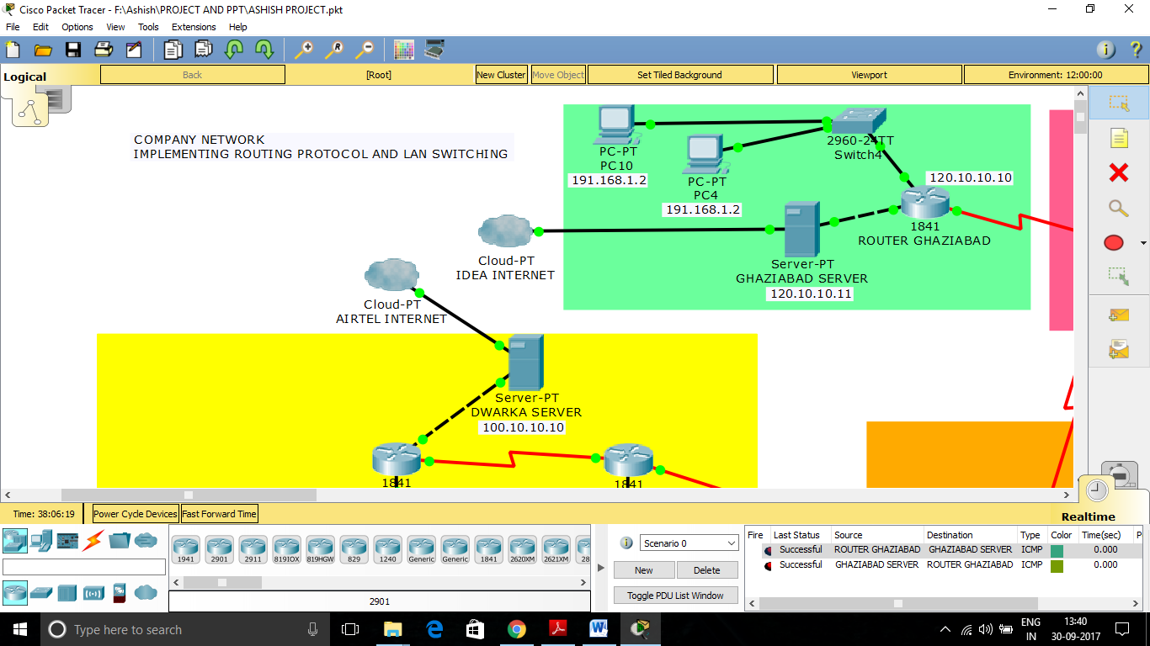
ANOTHER NETWORK SHOWING PC COMMUNICATING TO ROUTER AND ROUTER TO PC & PC TO PC
GHAZIABAD ROUTER COMMUNICATING WITH GHAZIABAD SERVER AND VICE VERSA

Slide 14
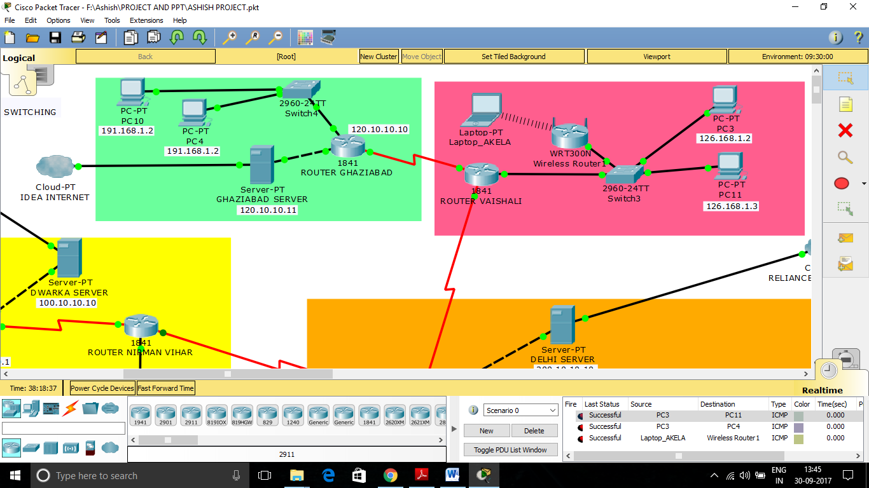
DIFFERENT NETWORKS COMMUNICATING TO EACH OTHER AND LAPTOP CONNECTED TO WIRELESS ROUTER

Slide 15
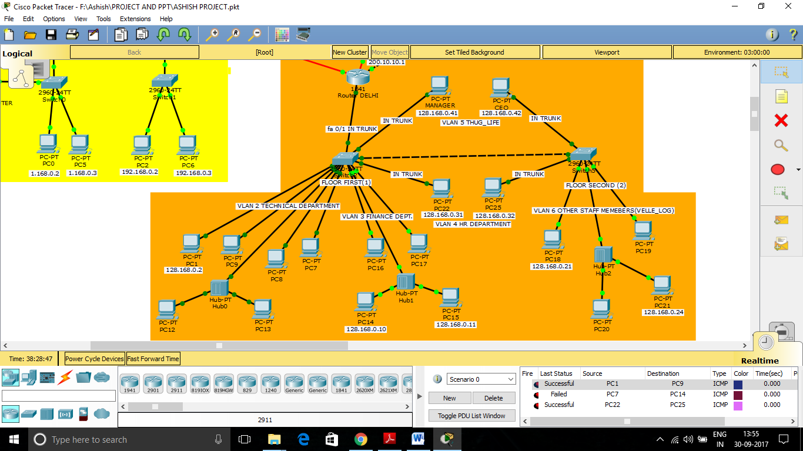
SAME VLANS ABLE TO COMMUNICATE

Slide 16

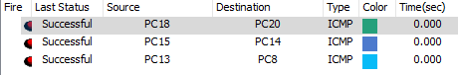
MANAGER AND CEO COMMUNICATING WITH EACH OTHER AND WITH HR DEPARTMENT
PCs CONNECTED WITH HELP OF HUBS ABLE TO COMMUNICATE IN NETWORK

Slide 17
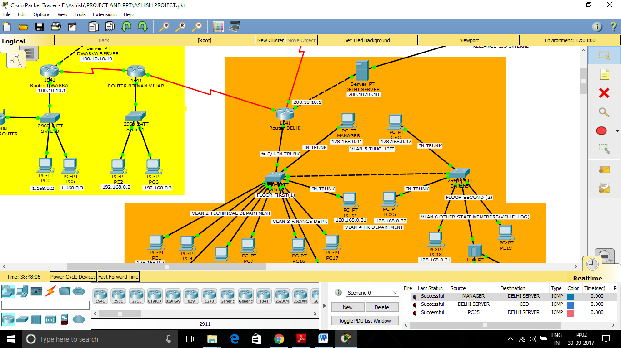
MANAGER AND CEO ABLE TO COMMUNICATE WITH DELHI’S SERVER

Slide 18
INDIVIDUAL WORK DONE
Ashish Kumar
Setting up the scenario for the company network (A random scenario is taken in the project as CCNA labs are created according to needs of customer)
Making connections in trunk for the different users to communicate with each other (Manager, CEO and HR department)
Configuring Routers, Switches, Hubs, Servers and End devices like laptops and PC’s for Router Delhi
IP addresses configuration in PC’s for the main headquarter network Delhi
Configuring Vlans for different department in Router Delhi Network (Technical, Finance, HR department and other users department)

Slide 19
Deepak Chopra
Implementing the best routing protocol for he given scenario (Routing Information Protocol, RIP)
IP addresses configuration in PC’s for the following network Nirman Vihar, Dwarka, Vaishali and Ghaziabad.
Configuring Routers, Switches, Wireless Router, Servers and End devices like laptops and PC’s for Router Nirman Vihar, Dwarka, Vaishali and Ghaziabad.
Checking for sending/receiving of data in the entire network
Enabling gateways for all PC’s in Nirman Vihar, Dwarka, Vaishali and Ghaziabad network and making sure the sending and receiving of data is done(package transfer viewing done in both realtime and simulation)

Slide 20


